Slide 1


010 Individual Presentation Guidelines
Dr Andre Samuel
andre.samuel@sam.edu.tt
http://samuellearning.org/scm.html

Slide 2
Requirements for Presentation

Slide 3
Individual Presentation
You will prepare a 20-minute presentation on your performance in the Beer Game.
Your presentation should be presented in business style
Submitted as a video on Canvas AND Slides on Turnitin
Use the on-line simulation game to understand the effects of supply chains on different ordering and effects of delays within your supply chain.
Identify the effects of the supply chain such as the bull whip affect

Slide 4
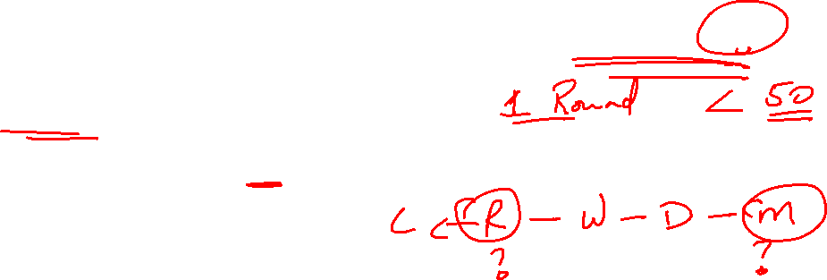
The Beergame
Ideally you should try to play the game for a minimum of 35 simulated weeks
Use the default settings otherwise
You can select any of the 4 role/tier to play the Game
You are only required to play 1 role
Record your strategy
  As you play the Game write down your idea/thoughts for the decision made
Download your results when the game is finished

Slide 5
Presentation Content and Structure

Slide 6
Title Slide
Module name
Presentation Title e.g. Beergame App- supply chain decisions to improve the performance of the overall beer supply chain
Student Number
Artwork

Slide 7
Aim and Contents
Outline purpose of the presentation
State what will be covered

Slide 8
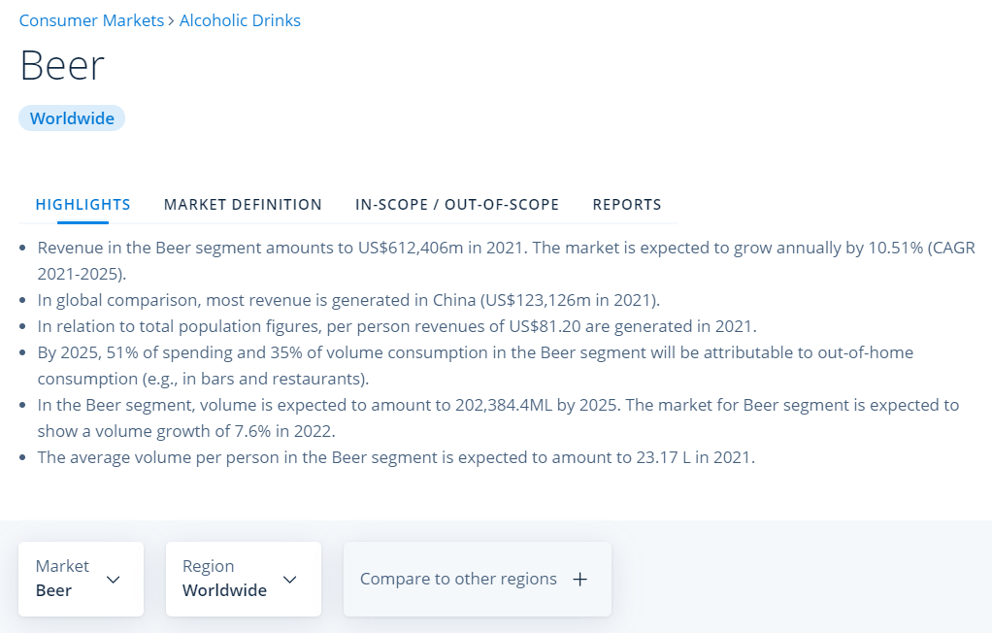
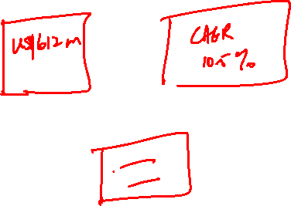
Beer Supply Chain
Give background into the Beer Industry
Current industry trends
https://www.statista.com/outlook/cmo/alcoholic-drinks/beer/worldwide

Slide 9
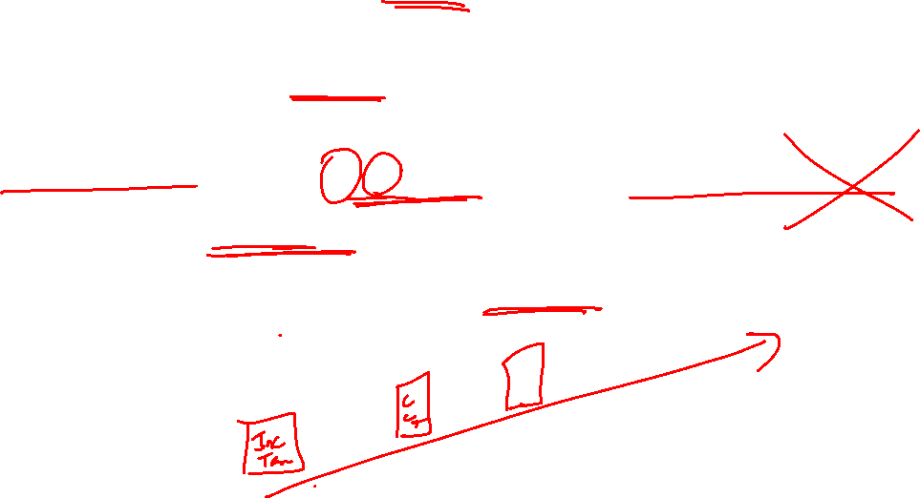
Current Risks and Challenges
Outline the current Risks facing the industry
  from perspective of your chosen role
Draw points from the PEST factors, but do not do a PEST
Not more than 5-7 solid points
Could use a diagram, tiles or infographic to articulate this on the slide

Slide 10
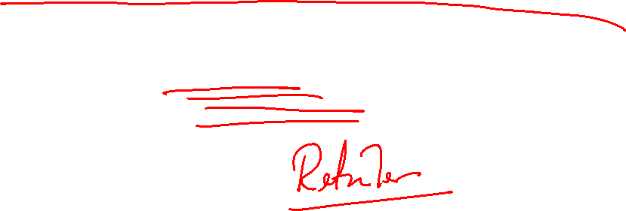
The Beergame
Give a Description of the Game
Include diagram of the 4 tier beer supply chain
Outline Purpose/aim of the Game
State which Role you played

Slide 11
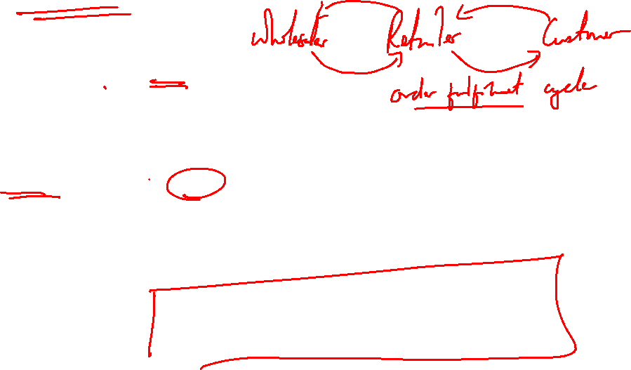
Role of (chosen stage)
Define the chosen role
Explain their purpose in the supply chain
  Use literature on the role
  Use research from the Beer Industry, does not have to be specific to a company/brand

Slide 12
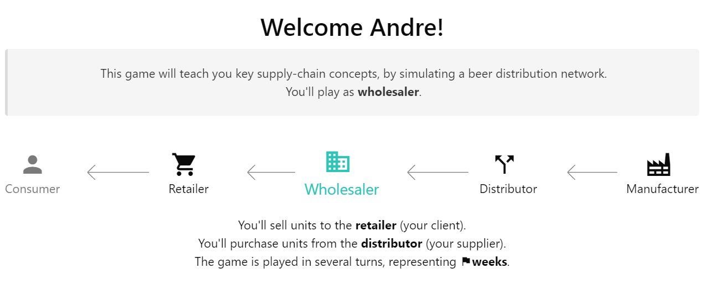
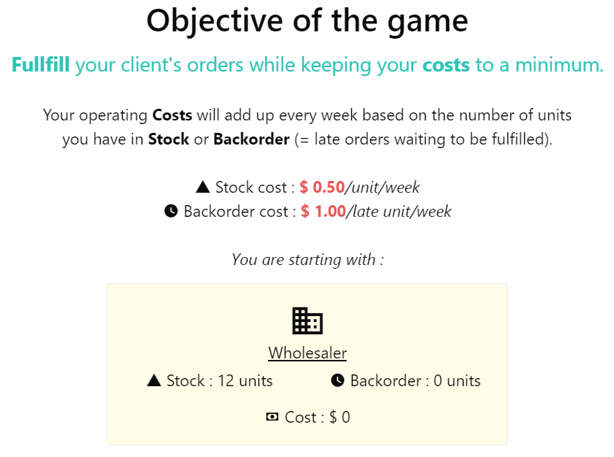
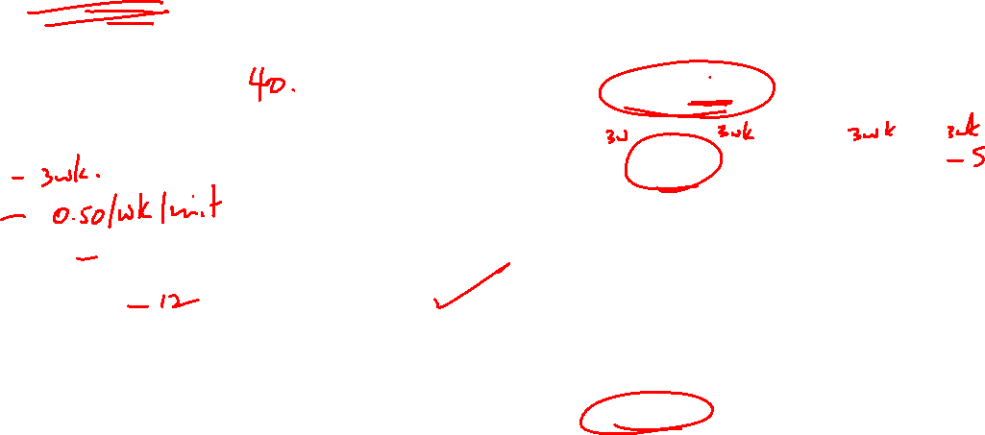
Beergame Settings
State:
  Number of Turns/Weeks completed
  Lead time
  Stock cost
  Backorder cost
  Starting stock level
Could use screenshot of instructions from the game
OR from the Settings page

Slide 13
Supply Chain Strategy Implemented
Discuss the Strategy used during the game.
Use Literature and relevant models to support your strategy choice
Discuss how it was implemented over the weeks
  Use Excel Data to point out strategy
  Annotate the spreadsheet
This should require a few slides so be meticulous

Slide 14
Trade-offs made
Discuss the trade off you made between:
  Efficiency/Cost: costs of stock-outs versus stock-holding costs
  Responsiveness: order fulfilment i.e. no backorders
  While playing the turns

Slide 15
Results and Analysis
Report on:
  Team Performance
  Individual Performance
    Cost
    % Units shipped on time
    Average Stock
    Average Orders
  Analysis of:
    Supply Chain evolution
    Stages Evolution
    Variability
Again, this make take a few slides
Use screenshots from the Beergame results page
Could even use spreadsheet to build your own charts
Make sure to provide an interpretation supported by literature
NB: it does not matter what the results are, as long as you can analyse and explain them

Slide 16
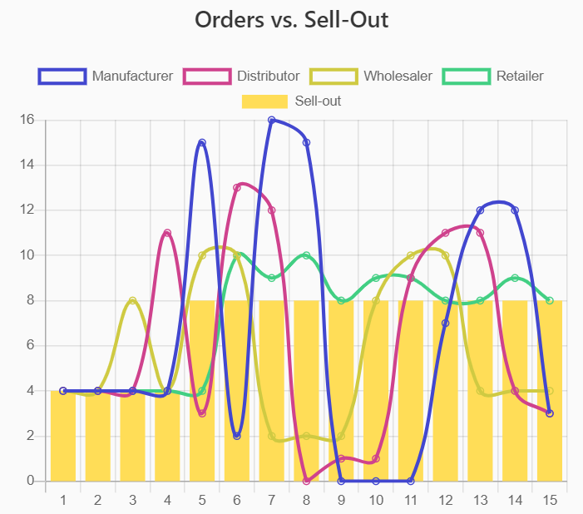
Bullwhip effect
Use literature here to explain what is the Bullwhip Effect
Identify the Causes and implications
Use charts from Beergame to explain
  Orders vs End Consumer Demand
  Stock/Backorders vs. End Consumer Demand
  Annotate the charts accordingly
Outline how to Mitigate Bullwhip effect
Again this may be a few slides.

Slide 17
Future strategies to improve supply chain operational performance
Here you would need to be creative and suggest alternative strategies
You can use any of your choice
Consider strategies discussed in class (lectures 4 and 5)
Make sure to explain and justify with literature

Slide 18
Conclusion
Discuss the Strengths of your strategy
Discuss Areas for Improvement
Recap future strategies that can be implemented
1 Slide max (it’s a summary)

Slide 19
Reference List

Slide 20
Groupwork reflection sheet (1 of 2)
Name:
Student Number:
Group you played the beer game with: | Group Number and Names
Link to the group space on Canvas: | NA
How are you submitting your video presentation?
Direct link - include link: | NA
Submitted as a file on Canvas | NA
Is it an individual or group video? (Please also state the group if different to the group you played the beer game with) | INDIVIDUAL
Rate your own contribution (1 = poor, 10 = excellent) | 1 | 2 | 3 | 4 | 5 | 6 | 7 | 8 | 9 | 10
Completion of the preparation activity before the beer game seminar (tutorial)
Participation in beer game decision making
Participation in the required discussion in class
Contributing with thoughts/ideas within the group
Respecting other group member’s feelings and time
You do not need to present this in your video – but this sheet must be completed individually and submitted with your video. It is worth 15% of the mark.

Slide 21
Groupwork reflection sheet (2 of 2)
How did your group mainly work?
Face to face |  | Online |  | Both
What did you enjoy during the group work part and what went well? | What challenges were faced during the group work? These could be encountered due to distance, working online or other challenges like personality clashes.
How did you overcome the challenges? | How would you work differently in face to face or online teams in the future?
You do not need to present this in your video – but this sheet must be completed individually and submitted with your video. It is worth 15% of the mark.

